Slide 1

Management Information Systems: Managing the Digital Firm
Fifteenth edition
Lecture 3
Foundations of Business
Intelligence:
Databases and
Information Management

Slide 2
File Organization Terms and Concepts
Database: Group of related files
File: Group of records of same type
Record: Group of related fields
Field: Group of characters as word(s) or number(s)
Entity: Person, place, thing on which we store information
Attribute: Each characteristic or quality describing entity
Notes:
This slide describes a hierarchy of data that is used to store information in a database, progressing from the database as the top-level holder of information down through the field, which stores information about an entity’s attribute. This hierarchy is illustrated by the graphic on the next slide. Ask students to come up with some other entities that might be found in a university database (Student, Professor, etc.). What attributes (characteristics) would be important to store in the database?

Slide 3
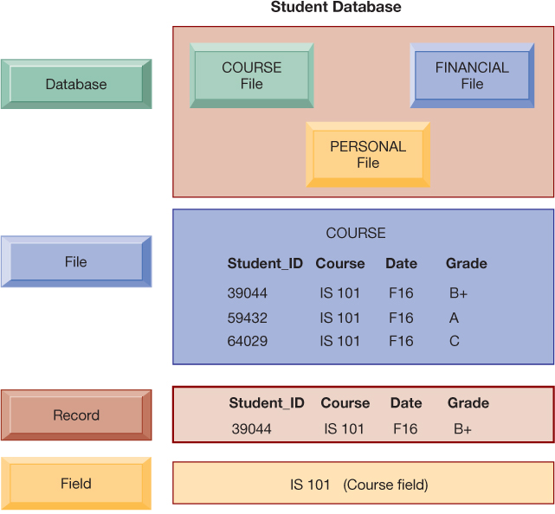
The Data structure
Notes:
A computer system organizes data in a hierarchy that starts with the bit, which represents either a 0 or a 1. Bits can be grouped to form a byte to represent one character, number, or symbol. Bytes can be grouped to form a field, and related fields can be grouped to form a record. Related records can be collected to form a file, and related files can be organized into a database.
This graphic illustrates the hierarchy of data found in a database. It shows the student course file grouped with files on students’ personal histories and financial backgrounds that form the student database. It illustrates what data is found at each hierarchical level, from the database level down

Slide 4
Problems with the Traditional File Environment
Files maintained individually by different departments
Data redundancy
Data conflict
Lack of flexibility
Poor security
Lack of data sharing and availability
Notes:
Choose 3

Slide 5
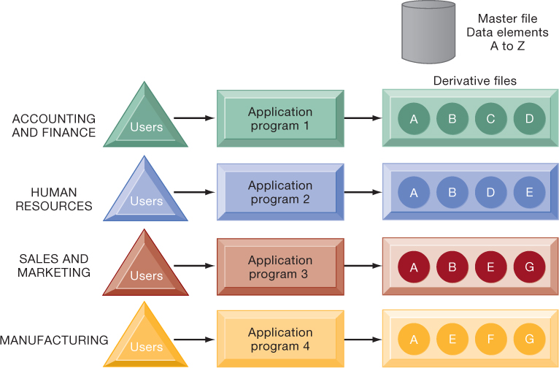
Traditional File Processing
Notes:
The use of a traditional approach to file processing encourages each functional area in a corporation to develop specialized applications. Each application requires a unique data file that is likely to be a subset of the master file. These subsets of the master file lead to data redundancy and inconsistency, processing inflexibility, and wasted storage resources.
This graphic illustrates a traditional environment, in which different business functions maintain separate data and applications to store and access that data. Ask students what kinds of data might be shared between accounting/finance and HR. What about between sales and marketing and manufacturing?

Slide 6
Database Management Systems (DBMS)
Database
  Supports multiple applications by centralizing information and minimizing data redundancy.
  Database management system (DBMS)
  Acts as an interface between applications and physical data files
  Addresses limitations of traditional file-based systems
  Minimizes data redundancy
  Prevents data inconsistency
  Allows centralized management of data and security
Notes:
This slide defines and describes databases and DBMS. Ask students to explain what the difference is between a database and a DBMS. What is the physical view of data? What is the logical view of data?

Slide 7
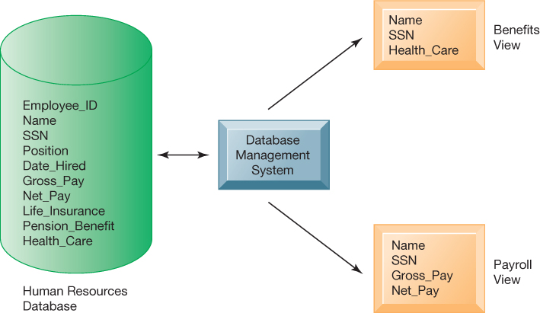
Human Resources Database with Multiple Views
A single HR database provides many different views of data, depending on the information requirements of the user.
One of interest to an employee benefits and one of interest to a member of the company’s payroll department.
Notes:
The orange rectangles represent two different views in an HR database, one for reviewing employee benefits, the other for accessing payroll records. The students can think of the green cylinder as the physical view, which shows how the data are actually organized and stored on the physical media. The physical data do not change, but a DBMS can create many different logical views to suit different needs of users.
SSN: Social Security Number

Slide 8
Relational DBMS
Data is organized into two-dimensional tables.
Each table stores information about entities and their attributes.
A table is a grid made up of columns and rows.
Rows represent individual records for different entities.
Columns correspond to attributes of the entities.
Primary key: the key field of a table that uniquely identifies its records.
Foreign key: a primary key from one table used in another table to reference its records.
Notes:
This slide introduces the most common type of DBMS in use with PCs, servers, and mainframes today, the relational database. Ask students why these DBMS are called relational. Ask students for examples of RDBMS software popular today and if they have every used any of this software. You can walk students through an example database that you have prepared in Access or use one of the exercise data tables found at the end of the chapter. Identify rows, fields, and primary key.

Slide 9
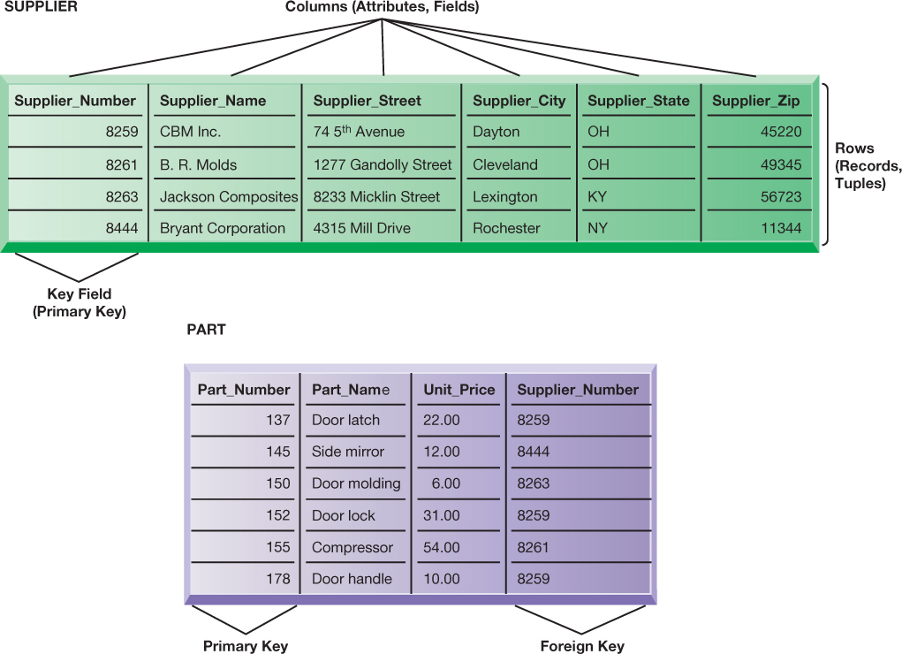
Relational Database Tables
Entities
Notes:
Figure 6.4, Page 219.
A relational database organizes data in the form of two-dimensional tables. Illustrated here are tables for the entities SUPPLIER and PART showing how they represent each entity and its attributes. Supplier_Number is a primary key for the SUPPLIER table and a foreign key for the PART table.
The graphic on this slide illustrates two tables in a relational DBMS. Ask students what the entity on this slide and the next are. The key field in the Supplier table is the Supplier number. What is the purpose of the key field?

Slide 10
Designing Databases
Conceptual design vs. physical design
Normalization: Organizing complex data sets to reduce redundancy.
Referential integrity: Rules enforced by the RDBMS to maintain consistent relationships between tables.
Entity-relationship diagram (ERD): A proper data model is important for a system to effectively support business operations.
Notes:
This slide describes activities involved in designing a database. To create an efficient database, you must know what the relationships are among the various data elements, the types of data that will be stored, and how the organization will need to manage the data. Note that the conceptual database design is concerned with how the data elements will be grouped, what data in what tables will make the most efficient organizations.
This slide continues the discussion about designing databases. One technique database designers use in modeling the structure of the data is to use an entity-relationship diagram (illustrated on the next slide). Symbols on the diagram illustrate the types of relationships between entities. Ask students what different types of relationships there are between entities (one-to-one, one-to-many, many-to-many).

Slide 11
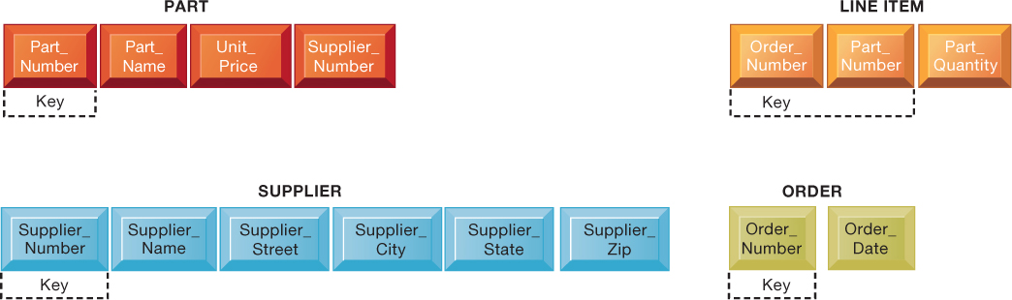
Unnormalized vs normalized Relation for Order
Unnormalized Tables
Normalized Tables
Notes:
An unnormalized relation contains repeating groups. For example, there can be many parts and suppliers for each order. There is only a one-to-one correspondence between Order_Number and Order_Date.
The graphics on this slide and the next illustrate the process of normalization. Here, one table lists the relevant data elements for the entity ORDER. These include all of the details about the order, the part, the supplier.
An order can include more than one part, and it may be that several parts are supplied by the same supplier. However, using this table, the supplier’s name, and other information might need to be stored several times on the order list.

Slide 12
Business Intelligence Infrastructure (1 of 3)
Array of tools for obtaining information from separate systems and from big data:
Data warehouses
  Store current and historical data from many core operational transaction systems
  Consolidate and normalize information for use across enterprise
  Provide analysis and reporting tools
Notes:
Business intelligence is a very amorphous notion that is not well defined. In this course we refer instead to a “business intelligence” environment which is composed of many different components (including both technology and management dimensions).
This slide discusses the use of data warehouses and data marts by firms.
Ask students why having a data warehouse is an advantage for firms hoping to perform business analyses on the data? Why does there have to be a repository of data that is separate from the transaction database?

Slide 13
Database vs Data warehouse
A database is for running the business (operations).
A data warehouse is for analyzing the business (strategy and decisions).

Slide 14
Business Intelligence Infrastructure (2 of 3)
Data marts
  Subset of data warehouse
  Typically focus on single subject or line of business
Hadoop
Is a framework for distributed storage and processing of big data on clusters of computers.
Key services
    Hadoop Distributed File System (HDFS): data storage
    MapReduce: breaks data into clusters for work
    Hbase: NoSQL database

Slide 15
Business Intelligence Infrastructure (3 of 3)
In-memory computing
Used in big data analysis and real-time processing
Stores data in the computer’s main memory (RAM) instead of disk storage
Eliminates delays caused by reading and writing to disks
Can reduce processing time from hours or days to seconds
Requires high-performance, optimized hardware
Analytic platforms
  High-speed platforms using both relational and non-relational tools optimized for large datasets

Slide 16
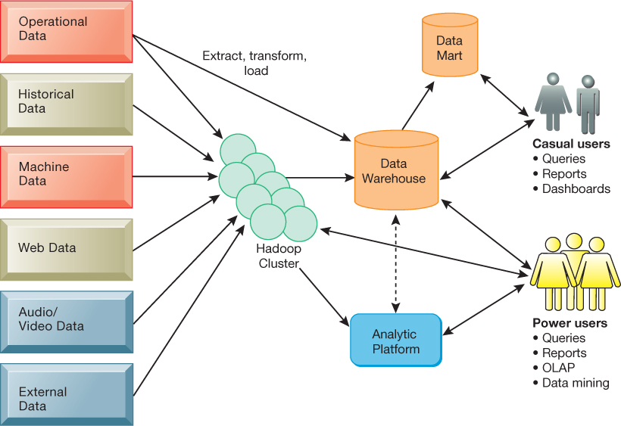
Modern Business Intelligence Infrastructure
Notes:
A modern business intelligence infrastructure features capabilities and tools to manage and analyze large quantities and different types of data from multiple sources. Easy-to-use query and reporting tools for casual business users and more sophisticated analytical toolsets for power users are included.
This graphic illustrates the components of a data warehouse system. It shows that the data warehouse extracts data from multiple sources, both internal and external, including a Hadoop cluster, and transforms it as needed for the data warehouse systems. An analytic platform has tools for power users, including reporting, and data mining, to extract meaningful information from the data warehouse and Hadoop cluster. A subset of the data warehouse is collected in a data mart for casual groups of users.

Slide 17
Analytical Tools: Relationships, Patterns, Trends
Tools for consolidating, analyzing, and providing access to vast amounts of data to help users make better business decisions
  Online Analytical Processing (OLAP)
  Data mining
  Text mining
  Web mining
Notes:
This slide illustrates the role and types of analytical tools and techniques for finding useful information and relationships in large data sets.

Slide 18
Online Analytical Processing (OLAP)
Supports multidimensional data analysis
  Viewing data using multiple dimensions
  Each aspect of information (product, pricing, cost, region, time period) is different dimension
OLAP enables rapid, online answers to ad hoc queries
Notes:
This slide discusses online analytical processing, one of the three principle tools for gathering business intelligence.
Ask students to come up with additional examples of what a multidimensional query might be.

Slide 19
Data Mining
Purpose: Discover hidden patterns, trends, and relationships within large datasets.
Predictive Power: Generates rules from historical data to forecast future behavior.
Types of information obtained from data mining:
  Associations: Relationships between items
  Sequences: Patterns over time
  Classification: Assigning data into predefined categories
  Clustering: Grouping similar data points without predefined categories
  Forecasting: Predicting future trends based on historical data
Notes:
This slide discusses another business intelligence tool driven by databases, data mining. Data mining provides insights into data that cannot be discovered through OLAP, by inferring rules from patterns in data.

Slide 20
Text Mining
Text mining
  Extracts key information from large unstructured datasets.
  Helps businesses analyze emails, surveys, call transcripts, legal documents, and service reports...
  Discovers patterns, relationships, and summarizes information for decision-making.
Notes:
Whereas data mining describes analysis of data in databases, there are other types of information that can be “mined,” such as text mining and web mining. Ask students what other types of unstructured textual data sets a company might store, and what kind of useful information might be extracted from them.
This slide continues the exploration of mining stored data for valuable information. In addition to text mining, there are several ways to mine information on the web. The text uses the example of marketers using Google Trends and Google Insights for Search services, which track the popularity of various words and phrases used in Google search queries, to learn what people are interested in and what they are interested in buying. What type of web mining is this? Why might a marketer be interested in the number of web pages that link to a site.

Slide 21
Web Mining
The process of discovering and analyzing useful patterns and information from the web to support decision-making or improve services.
Types of Web Mining:
Web Content Mining: Extracts information from web pages and online documents (e.g., text, images, videos).
Web Structure Mining: Analyzes the link structure of websites to understand relationships between pages.
Web Usage Mining: Studies user behavior through browsing patterns.

